Slide 1
.NET Framework Overview
.NET Framework, CLR, MSIL, Assemblies, CTS, etc.
Svetlin Nakov
Telerik Corporation
www.telerik.com

Slide 2

Table of Contents
What is .NET?
Microsoft .NET platform architecture
What is .NET Framework?
.NET Framework Architecture
Common Language Runtime (CLR)
Managed Code
Intermediate Language MSIL
Assemblies and Metadata
.NET Applications

Slide 3
Table of Contents (2)
Common Language Infrastructure (CLI) and integration of different languages
Common Language Specification (CLS)
Common Type System (CTS)
Framework Class Library
Integrated Development Environment Visual Studio

Slide 4

.NET Framework
Microsoft's Platform for Application Development

Slide 5
. Net Framework –Quick Overview
a software framework developed by Microsoft that runs primarily on Microsoft Windows.
includes a large library and provides language interoperability (each language can use code written in other languages) across several programming languages.
Programs written for the .NET Framework execute in a software environment (as contrasted to hardware environment), known as the Common Language Runtime (CLR)
CLR is an application virtual machine that provides services such as security, memory management, and exception handling.
The class library and the CLR together constitute the .NET Framework.

Slide 6
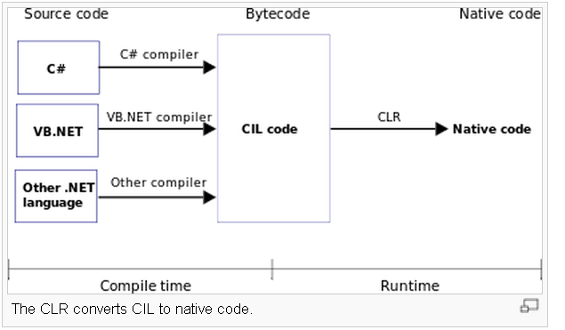
. .Net Framework –Quick Overview
Compiled into CLR modules
library .Dll
Executable .Exe
Platform Neutral Language
Runs on a specific platform
All .Net code (regardless of language) is compiled into an common intermediate language (CIL, also called MSIL microsoft IL)
This IL is what is actually executed when you ruin the program

Slide 7
Common Language Runtime (CLR)
The Common Language Runtime (CLR) is the virtual machine component of Microsoft's .NET framework
It is responsible for managing the execution of .NET programs.
Code is compiled to IL (Intermediate language)
The CLR then executes this by converting into machine instructions (in a process known as Just-in-time compilation)
These machine instructions can then be executed by the computer's CPU.
The CLR provides additional services including memory management, type safety, exception handling, garbage collection and thread management.
All programs written for the .NET framework, regardless of programming language, are executed by the CLR.
CLR is common to all versions of the .NET framework.

Slide 8
What is the .NET Platform?
The .NET platform
Microsoft's platform for software development
Unified technology for development of almost any kind of applications
GUI / Web / RIA / mobile / server / cloud / etc.
.NET platform versions
.NET Framework
Silverlight / Windows Phone 7
.NET Compact Framework

Slide 9
What is .NET Framework?
.NET Framework
An environment for developing and executing .NET applications
Unified programming model, set of languages, class libraries, infrastructure, components and tools for application development
Environment for controlled execution of managed code
It is commonly assumed that
.NET platform == .NET Framework

Slide 10
.NET Framework Components
Common Language Runtime (CLR)
Environment for controlled execution of programmed code – like a virtual machine
Executes .NET applications
Framework Class Library (FCL)
Standard class library for .NET development
Delivers basic functionality for developing: XML, ADO.NET, LINQ, ASP.NET, WPF, WCF, WWF, Silverlight, Web services, Windows Forms, ...
SDK, compilers and tools

Slide 11
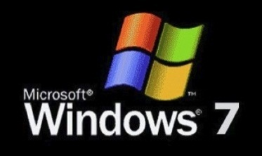

.NET Framework Architecture
The OS manages the resources, the processes and the users of the machine
Provides to the applications some services (threads, I/O, GDI+, DirectX, COM, COM+, MSMQ, IIS, WMI, …)
CLR is a separate process in the OS
Operating System (OS)

Slide 12
.NET Framework Architecture (2)
CLR manages the execution of the.NET code
Manages the memory, concurrency, security, ...
CLR
Common Language Runtime (CLR)
Operating System (OS)

Slide 13
.NET Framework Architecture (3)
Rich object-oriented library with fundamental classes
Input-output, collections, text processing, networking, security, multi-threading, …
Base Class Library (BCL)
Common Language Runtime (CLR)
Operating System (OS)

Slide 14
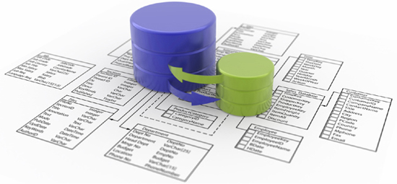
.NET Framework Architecture (4)
Database access
ADO.NET, LINQ, LINQ-to-SQL and Entity Framework
Strong XML support
ADO.NET, LINQ and XML (Data Tier)
Base Class Library (BCL)
Common Language Runtime (CLR)
Operating System (OS)

Slide 15
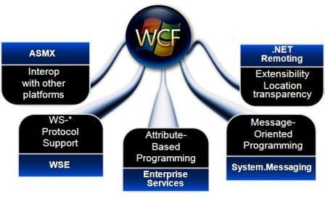
.NET Framework Architecture (5)
Windows Communication Foundation (WCF) and Windows Workflow Foundation (WWF) for the SOA world
WCF and WWF (Communication and Workflow Tier)
ADO.NET, LINQ and XML (Data Tier)
Base Class Library (BCL)
Common Language Runtime (CLR)
Operating System (OS)

Slide 16
.NET Framework Architecture (6)
User interface technologies: Web based, Windows GUI, WPF, Silverlight, mobile, …
ASP.NET
Web Forms, MVC, AJAX
Mobile Internet Toolkit
Windows
Forms
WPF
Silverlight
WCF and WWF (Communication and Workflow Tier)
ADO.NET, LINQ and XML (Data Tier)
Base Class Library (BCL)
Common Language Runtime (CLR)
Operating System (OS)

Slide 17
.NET Framework Architecture (7)
Programming language on your flavor!
C#
C++
VB.NET
J#
F#
JScript
Perl
Delphi
…
ASP.NET
Web Forms, MVC, AJAX
Mobile Internet Toolkit
Windows
Forms
WPF
Silverlight
WCF and WWF (Communication and Workflow Tier)
ADO.NET, LINQ and XML (Data Tier)
Base Class Library (BCL)
Common Language Runtime (CLR)
Operating System (OS)

Slide 18
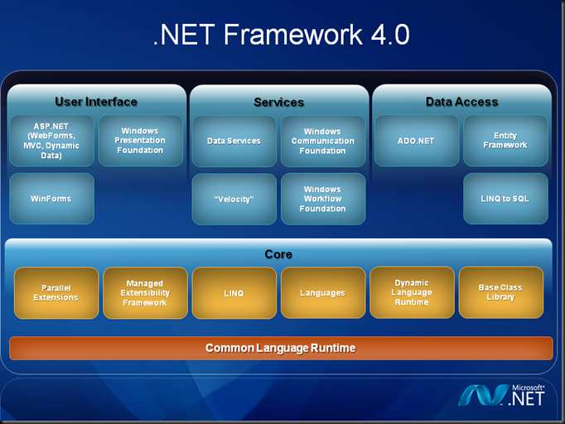
.NET Framework 4.0

Slide 19

Common Language Runtime (CLR)
The Heart of .NET Framework

Slide 20

Common Language Runtime (CLR)
Managed execution environment
Controls the execution of managed .NET programming code
Something like virtual machine
Like the Java Virtual Machine (JVM)
Not an interpreter
Compilation on-demand is used
Known as Just In Time (JIT) compilation
Possible compilation in advance (Ngen)

Slide 21

Responsibilities of CLR
Execution of the IL code and the JIT compilation
Managing memory and application resources
Ensuring type safety
Interaction with the OS
Managing security
Code access security
Role-based security

Slide 22

Responsibilities of CLR (2)
Managing exceptions
Managing concurrency – controlling the parallel execution of application threads
Managing application domains and their isolation
Interaction with unmanaged code
Supporting debug / profile of .NET code

Slide 23
CLR Architecture
Base Class Library Support
Thread Support
COM Marshaler
Type Checker
Exception Manager
Security Engine
Debug Engine
IL to Native
JIT Compiler
Code
Manager
Garbage
Collector
Class Loader

Slide 24
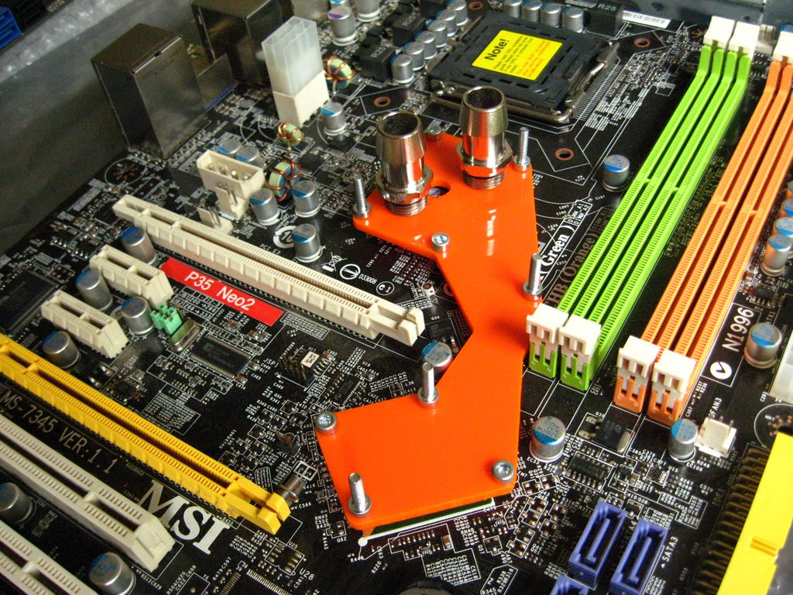
Managed and Unmanaged Code
What is the Difference?

Slide 25
Managed Code
CLR executed code is called managed code
Represents programming code in the low level language MSIL (MS Intermediate Language)
Contains metadata
Description of classes, interfaces, properties, fields, methods, parameters, etc.
Programs, written in any .NET language are
Compiled to managed code (MSIL)
Packaged as assemblies (.exe or .dll files)

Slide 26

Managed Code (2)
Object-oriented
Secure
Reliable
Protected from irregular use of types (type-safe)
Allows integration between components and data types of different programming languages
Portable between different platforms
Windows, Linux, Max OS X, etc.

Slide 27
Unmanaged (Win32) Code
No protection of memory and type-safety
Reliability problems
Safety problems
Doesn’t contain metadata
Needs additional overhead like (e.g. use COM)
Compiled to machine-dependent code
Need of different versions for different platforms
Hard to be ported to other platforms

Slide 28
Memory Management
CLR manages memory automatically
Dynamically loaded objects are stored in the managed heap
Unusable objects are automatically cleaned up by the garbage collector
Some of the big problems are solved
Memory leaks
Access to freed or unallocated memory
Objects are accessed through a reference

Slide 29

Intermediate Language (MSIL)

Slide 30

Intermediate Language (MSIL, IL, CIL)
Low level language (machine language) for the .NET CLR
Has independent set of CPU instructions
Loading and storing data, calling methods
Arithmetic and logical operations
Exception handling
Etc.
MSIL is converted to instructions for the current physical CPU by the JIT compiler

Slide 31

Sample MSIL Program
.method private hidebysig static void Main() cil managed
{
.entrypoint
// Code size 11 (0xb)
.maxstack 8
ldstr "Hello, world!"
call void
[mscorlib]System.Console::WriteLine(string)
ret
} // end of method HelloWorld::Main

Slide 32









Compilation and Execution
Assembly
(.EXE or
.DLL file)
Compilation
Source code
Language compiler
Code
MSIL
Metadata
When given method is called for the first time
Execution
Pre-compilation during the install (NGEN)
Machine code
JIT compiler

Slide 33

How CLR Executes MSIL?
.EXE / .DLL
Class libraries
Class Loader
trusted
code
Verifier
already compiled code
JIT
compiler
Call un-compiled method
Managed code (MSIL)
Code
Manager
Security
Engine
Execution

Slide 34

.NET Applications
Assemblies, Metadata and Applications

Slide 35
.NET Assemblies
.NET assemblies:
Self-containing .NET components
Stored in .DLL and .EXE files
Contain list of classes, types and resources
Smallest deployment unit in CLR
Have unique version number
.NET deployment model
No version conflicts (forget the "DLL hell")
Supports side-by-side execution of different versions of the same assembly

Slide 36

Metadata in the Assemblies
Metadata in the .NET assemblies
Data about data contained in the assembly
Integral part of the assembly
Generated by the .NET languages compiler
Describes all classes, their class members, versions, resources, etc.
Notes:
Metadata
Information about program structure is language-agnostic, so that it can be referenced between languages and tools, making it easy to work with code written in a language you are not using.
.NET metadata, in the Microsoft .NET framework, refers to code that describes .NET CIL (Common Intermediate Language) code. A .NET language compiler will generate the metadata and store this in the assembly containing the CIL. Metadata describes all classes and class members that are defined in the assembly, and the classes and class members that the current assembly will call from another assembly. The metadata for a method contains the complete description of the method, including the class (and the assembly that contains the class), the return type and all of the method parameters. When the CLR executes CIL it will check to make sure that the metadata of the called method is the same as the metadata that is stored in the calling method. This ensures that a method can only be called with exactly the right number of parameters and exactly the right parameter types.

Slide 37

Metadata in Assemblies
Type Description
Classes, interfaces, inner types, base classes, implemented interfaces, member fields, properties, methods, method parameters, return value,
attributes, etc.
Assembly Description
Name
Version
Localization
[digital
signature]
Dependencies on other assemblies
Security permissions
Exported types

Slide 38
.NET Applications
Configurable executable .NET units
Consist of one or more assemblies
Installed by "copy / paste"
No complex registration of components
Different applications use different versions of common assemblies
No conflicts due to their "strong name"
Easy installation, un-installation and update

Slide 39

Common Language Infrastructure
How .NET Supports Multiple Languages?

Slide 40
Common Language Infrastructure
Common Language Infrastructure (CLI)
Open specification developed by Microsoft (ECMA – 335)
Multiple high-level languages run on different platforms without changes in the source code or pre-compilation
Standardized part of CLR
.NET Framework is CLI implementation for Windows
Mono is CLI implementation for Linux
Notes:
The Common Language Infrastructure (CLI) is an open specification developed by Microsoft that describes the executable code and runtime environment that form the core of the Microsoft .NET Framework. The specification defines an environment that allows multiple high-level languages to be used on different computer platforms without being rewritten for specific architectures.
To clarify, the CLI is a specification, not an implementation, and is often confused with the Common Language Runtime (CLR), which contains aspects outside the scope of the specification.

Slide 41

Common Language Infrastructure (2)
CLI describes four aspects:
The Common Type System (CTS)
Assemblies and metadata
Common Language Specification (CLS)
Virtual Execution System (VES)
Notes:
The Common Type System (CTS)
A set of types and operations that are shared by all CTS-compliant programming languages.
Metadata
Information about program structure is language-agnostic, so that it can be referenced between languages and tools, making it easy to work with code written in a language you are not using.
Common Language Specification (CLS)
A set of base rules to which any language targeting the CLI should conform in order to interoperate with other CLS-compliant languages.
Virtual Execution System (VES)
The VES loads and executes CLI-compatible programs, using the metadata to combine separately generated pieces of code at runtime.
All compatible languages compile to Common Intermediate Language (CIL), which is an intermediate language that is abstracted from the platform hardware. When the code is executed, the platform-specific VES will compile the CIL to the machine language according to the specific hardware.

Slide 42
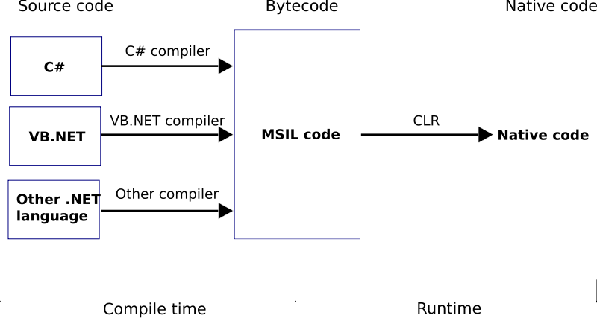
.NET Code Compilation and Execution

Slide 43
Common Type System (CTS)
CTS defines the CLR supported types of data and the operations over them
Ensures data level compatibility between different .NET languages
E.g. string in C# is the same like String in VB.NET and in J#
Value types and reference types
All types derive from System.Object

Slide 44
Common Language Specification (CLS)
CLS is a system of rules and obligations, that all .NET languages must obey
Ensures compatibility and ease of interaction between .NET languages
Example: CLS enforces all .NET languages to be object-oriented
When using non-CLS-compliant programming techniques you lose compatibility with the other .NET languages

Slide 45

The .NET Languages
C#, VB.NET, C++, J#, etc.

Slide 46
.NET Languages
.NET languages by Microsoft
C#, VB.NET, Managed C++, J#, F#, JScript
.NET languages by third parties
Object Pascal, Perl, Python, COBOL, Haskell, Oberon, Scheme, Smalltalk…
Different languages can be mixed in a single application
Cross-language inheritance of types and exception handling

Slide 47
C# Language
C# is mixture between C++, Java and Delphi
Fully object-oriented by design
Component-oriented programming model
Components, properties and events
No header files like C/C++
Suitable for GUI and Web applications
XML based documentation
In C# all data types are objects
Example: 5.ToString() is a valid call

Slide 48
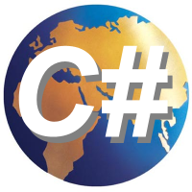
C# Language – Example
C# is standardized by ECMA and ISO
Example of C# program:
using System;
class NumbersFrom1to100
{
static void Main()
{
for (int i=1; i<=100; i++) {
Console.WriteLine(i);
}
}
}

Slide 49

Framework Class Library (FCL)
Standard Out-of-the-box .NET APIs

Slide 50
Framework Class Library (FCL)
Framework Class Library is the standard .NET Framework library of out-of-the-box reusable classes and components (APIs)
ASP.NET
Web Forms, MVC, AJAX
Mobile Internet Toolkit
Windows
Forms
WPF
Silverlight
WCF and WWF (Communication and Workflow Tier)
ADO.NET, LINQ and XML (Data Tier)
Base Class Library (BCL)

Slide 51
FCL Namespaces
ASP.NET
Web Forms, MVC, AJAX
Mobile Internet Toolkit
Windows
Forms
WPF & Silverlight
System.Windows
System.Windows.Forms
System.Web
System.Windows.Media
System.Web.Mvc
System.Drawing
System.Windows.Markup
WCF and WWF (Communication and Workflow Tier)
System.ServiceModel
System.Activities
System.Workflow
ADO.NET, LINQ and XML (Data Tier)
System.Data
System.Linq
System.Xml
System.Data.Linq
System.Xml.Linq
System.Data.Entity

Slide 52

Visual Studio IDE
Powerful Development Environment for .NET

Slide 53

Visual Studio
Visual Studio is powerful Integrated Development Environment (IDE) for .NET Developers
Create, edit, compile and run .NET applications
Different languages – C#, C++, VB.NET, J#, …
Flexible code editor
Powerful debugger
Integrated with SQL Server and IIS
Strong support of Web services, WCF and WWF

Slide 54
Visual Studio (2)
Visual programming
Component-oriented, event based
Managed and unmanaged code
Helpful wizards and editors
Windows Forms Designer
WCF / Silverlight Designer
ASP.NET Web Forms Designer
ADO.NET / LINQ-to-SQL / XML Data Designer
Many third party extensions

Slide 55
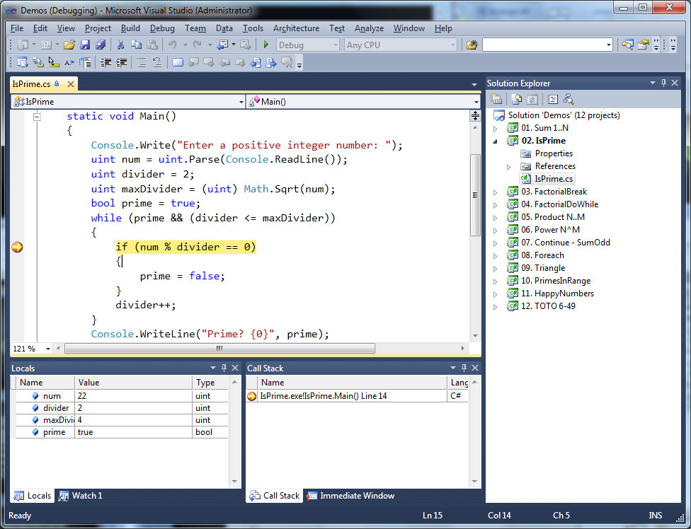
Visual Studio IDE

Slide 56
.NET Framework Overview
?
?
?
?
?
Questions?
?
?
?
?
?
http://aspnetcourse.telerik.com

Slide 57
Exercises
Describe briefly .NET Framework. Indicate its key components?
What is Common Language Runtime (CLR)? Why it is important part of .NET Framework?
What is .NET assembly? What are its integral parts?
What is the assembly metadata and what does it contain?
Describe the process of compilation of C# program to assembly and the process of assembly execution.
What is managed code? Why it is preferred over the traditional unmanaged (native) code?

Slide 58
Exercises (2)
What is MSIL language? Indicate its key characteristics.
What is Common Language Specification (CLS)? Why is it developed?
What is Common Type System? When is it used?
Point out some of the most popular .NET languages. What is common for all of them?
What is Framework Class Library (FCL)? What functionality does it deliver? Indicate its key technologies and namespaces.

